Slide 1
Paging
Dept. of Information Technology,
Jadavpur University, Kolkata

Slide 2
Introduction
Paging is a dynamic relocation technique
Using paging we can avoid external fragmentation
May have some internal fragmentation
Internal fragmentation on an average is of the size of one half page per process
User program views memory as one single space
In this scheme the logical addresses are translated into physical addresses by the OS and is hidden from the user

Slide 3
Paging
Logical address space of a process can be noncontiguous; process is allocated physical memory whenever it is available
Divide physical memory into fixed-sized blocks called frames (size is power of 2, between 512 bytes and 8,192 bytes)
Divide logical memory into blocks of same size called pages
Keep track of all free frames
To run a program of size n pages, need to find n free frames and load program
Set up a page table which page is loaded where
Advantage
  Address space need not be contiguous
Problem
  Internal fragmentation

Slide 4

Address Translation Scheme
Address generated by CPU is divided into:
  Page number (p)
    used as an index into a page table which contains base address of each page in physical memory
  Page offset (d)
    combined with base address to define the physical memory address that is sent to the memory unit
  For given logical address space 2^{m} and page size 2^{n}
page number
page offset
p
d
m - n
n

Slide 5
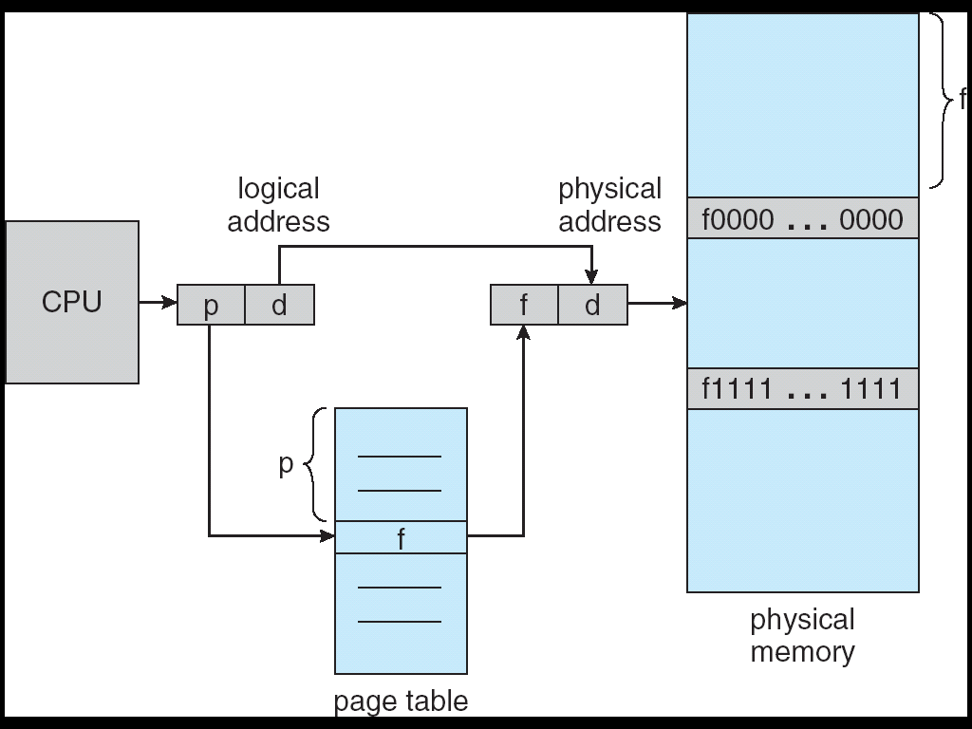
Paging Hardware

Slide 6

Paging Model of Logical and Physical Memory

Slide 7

Paging Example page size 4 bytes memory 3 bytes
page size 4 bytes
memory 32 bytes
Logical address 0 is page 0, offset 0. we find that page 0 is in frame 5.
Thus, logical address 0 maps to physical address 20 (= (5 x 4) + 0).
Logical address 3 (page 0, offset 3) maps to physical address 23 = (5x4 ) + 3). Logical address 4 is page 1, offset 0; according to the page table, page 1 is mapped to frame 6. Thus, logical address 4 maps to physical address 24 (= (6x4) + 0).
Logical address 13 maps to physical address maps to ??

Slide 8
Overhead of paging
The OS maintains a copy of page table for each
process with the register sets and a pointer to the
PT is stored in the PCB.
IT is used by the dispatcher when a process is to be
allocated to CPU
Paging thus increases context switching time

Slide 9

Free Frames
Before allocation
After allocation

Slide 10
Implementation of Page Table
Page table is kept in registers : very small in size
Page table is kept in main memory
Page-table base register (PTBR) points to the page table
Problem
  In this scheme every data/instruction access requires two memory accesses. One for the page table and one for the data/instruction.
Solution
  The two memory access problem can be solved by the use of a special fast-lookup hardware cache called associative memory or translation look-aside buffers (TLBs)
  TLB stores a fraction of total information of page table

Slide 11
Associative Memory
Associative memory – parallel search
Address translation (p, d)
  If p is in associative register, get frame # out
  Otherwise get frame # from page table in memory
Page #
Frame #
2 | 6
4 | 2
50 | 5
51 | 10

Slide 12

Paging Hardware With TLB

Slide 13
Effective Access Time
Associative Lookup = ε time unit
Assume memory cycle time is 1 microsecond
Hit ratio – percentage of times that a page number is found in the associative registers; ratio related to number of associative registers
Hit ratio = α
Effective Access Time (EAT)
EAT = (1 + ε) α + (2 + ε)(1 – α)
= 2 + ε – α
Example
Access time of TLB = 20 ns
Access time of memory = 100 ns
Hit ratio = 0.8
EAT = 0.8x120 + 0.2x220 = 140 ns → 40% slow down
α = 0.98, EAT = 0.98x120 + 0.02x220 = 122 → 22% slow down

Slide 14
Memory Protection
Memory protection implemented by associating protection (read/write) bit with each frame
Finer level of protection can be implemented by adding more bits
Valid-invalid bit attached to each entry in the page table:
  “valid” indicates that the associated page is in the process’ logical address space, and is thus a legal page
  “invalid” indicates that the page is not in the process’ logical address space
  Example:
    14-bit address→0-16,383 out of which 0-12,287 can be used
    Page size 2K→ first 6 pages (0 through 5) are valid, rest (page 6 & 7) are invalid

Slide 15

Valid (v) or Invalid (i) Bit In A Page Table

Slide 16
Shared Pages
Shared code
  One copy of read-only (reentrant) code shared among processes (i.e., text editors, compilers, window systems).
  Shared code must appear in same location in the logical address space of all processes
  Heavily used programs can also be shared - compilers, window systems, runtime libraries…
Private code and data
  Each process keeps a separate copy of the code and data
  The pages for the private code and data can appear anywhere in the logical address space

Slide 17
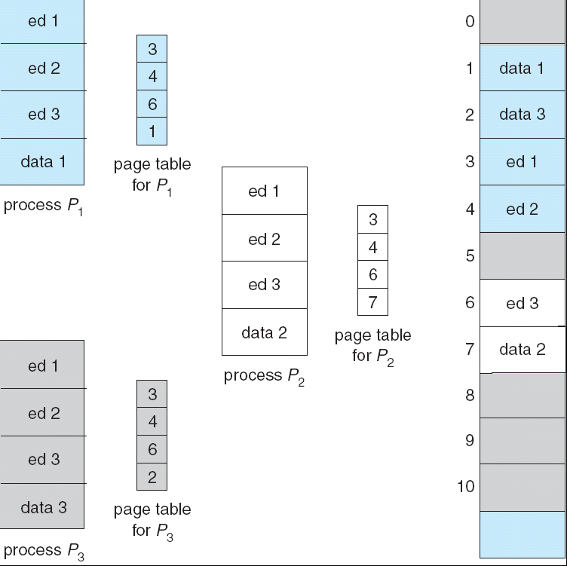
Shared Pages Example

Slide 18
Hierarchical Page Tables
Modern computer systems support a large logical address space (232 to 264).
Example, consider a system with a 32-bit logical address space. If the page size in such a system is 4 KB (2¹² ),
A page table may consist of up to 1 million entries (2³² / 2¹² ). Assuming that each entry consists of 4 bytes,
May need up to 4 MB of physical address space for the page table alone !!
One simple solution to this problem is to divide the page table into smaller pieces
Break up the logical address space into multiple page tables
A simple technique is a two-level page table

Slide 19
Two-Level Paging Example
An example
A logical address (on 32-bit machine with 4K page size) is divided into:
  a page number consisting of 20 bits
  a page offset consisting of 12 bits
Size of page table? 4 Mbytes
Solution—break the page table in number of pages
Since the page table is paged, the page number is further divided into:
  a 10-bit page number
  a 10-bit page offset
Thus, a logical address is as follows:
where p₁ is an index into the outer page table, and p₂ is the displacement within the page of the outer page table
page number
page offset
p₁
p₂
d
10
10
12

Slide 20

Two-Level Page-Table Scheme

Slide 21

Address-Translation Scheme

Slide 22
Effective Access Time
Associative Lookup = ε time unit
Assume memory cycle time is T microsecond
Hit ratio = α
Effective Access Time (EAT)
EAT = (T + ε) α + (3T + ε)(1 – α)
= 3T + ε – 2Tα

Slide 23


Three-level Paging Scheme

Slide 24
Inverted Page Table
One entry for each real page of memory
Entry consists of the page number stored in that frame, and the process that owns the page
  <page-number, process-id>
Logical address consists of a triple:
  <process-id, page-number, offset>
Inverted page table is of the form:

Slide 25

Inverted Page Table Architecture

Slide 26
Inverted Page Table
Advantage
  Decreases memory needed to store each page table
Disadvantage
  Increases time needed to search the table when a page reference occurs

Slide 27


Segmentation
Paging does not support user’s view of memory
Segmentation Memory-management scheme supports user view of memory
User’s view
  A program is a collection of segments/ modules. A segment is a logical unit such as:
    main program,
    procedure,
    function,
    method,
    object,
    local variables, global variables,
    common block,
    stack,
    symbol table, arrays

Slide 28
Logical View of Segmentation
1
4
1
2
3
2
4
3
3
user space
physical memory space

Slide 29

Segmentation Architecture
Logical address consists of a two parts (for paging a single address is specified):
  <segment-number, offset>,
Segmentation hardware
  Segment table – maps two-dimensional physical addresses; each table entry is of the form <base, limit>
    base – contains the starting physical address where the segment resides in memory
    limit – specifies the length of the segment

Slide 30

Example of Segmentation

Slide 31
Segmentation Architecture (Cont.)
Implementation of segment table
  Segment-table base register (STBR)
    points to the segment table’s location in memory
  Segment-table length register (STLR)
    indicates number of segments used by a program;
  segment number s is legal if s < STLR
Protection
  With each entry in segment table associate:
    validation bit = 0 ⇒ illegal segment
    read/write/execute privileges
  Protection bits associated with segments; code sharing occurs at segment level
External Fragmentation
  Since segments vary in length, memory allocation is a dynamic storage-allocation problem
Segmentation with paging

